Slide 1


Social Buzz
Categorial analysis

Slide 2


Today's agenda
Project recap
Problem
The Analytics team
Process
Insights
Summary

Slide 3

Social Buzz, is a fast-growing technology unicorn that needs to adapt quickly to its global scale. Accenture has begun a 3-month POC focusing on these tasks:
An audit of their big data practice
Recommendations for a successful IPO
An analysis of their content categories that highlight the top 5 categories with the largest aggregate popularity
Project Recap

Slide 4


Problem
Over 100,000 posts per day 36,500,000 pieces of content per year!
But how do we capitalize on it when there is so much?
Analysis to find Social Buzz’s top 5 most popular categories of content

Slide 5



Vishal Kumar
Data Analyst
The Analytics team
Marcus Rompton
Senior principle
Andrew Fleming
Chief Technical Architect

Slide 6
Process
1
Data understanding
2
Data Cleaning
3
Data Modeling
4
Data Analysis
5
Uncover Insights

Slide 7

Insights
This report analyzes the top 5 content categories based on their performance metrics, sentimental value, and engagement across different content types over the past month.
Firstly we see the Top 5 categories based on how many numbers of customers engaged in the content of these categories.
Secondly, we see the same top 5 categories based on the sentimental value and popularity of the content of these categories.
Next, we see the top 5 categories journey over the period in quarters and we see that the popularity in the first quarter is quite low and then it takes high growth in it.
Then we see the percentage of different sentimental types in these categories.
Lastly, we see the top 5 categories of the different content types which helps them to make decisions on the different types of content.

Slide 8
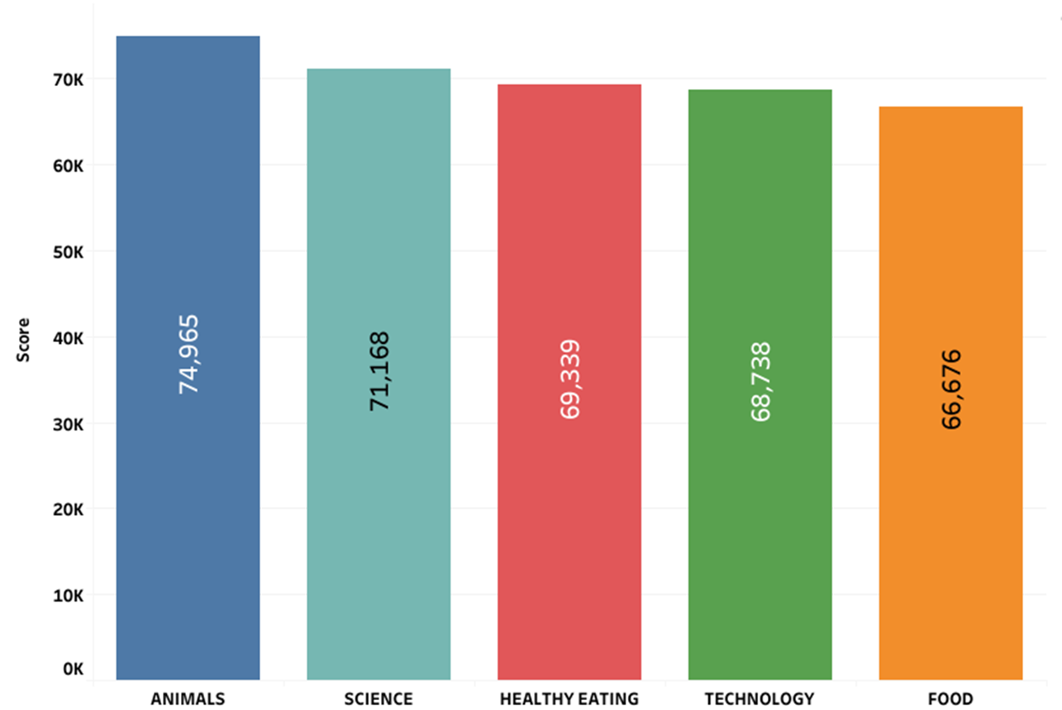
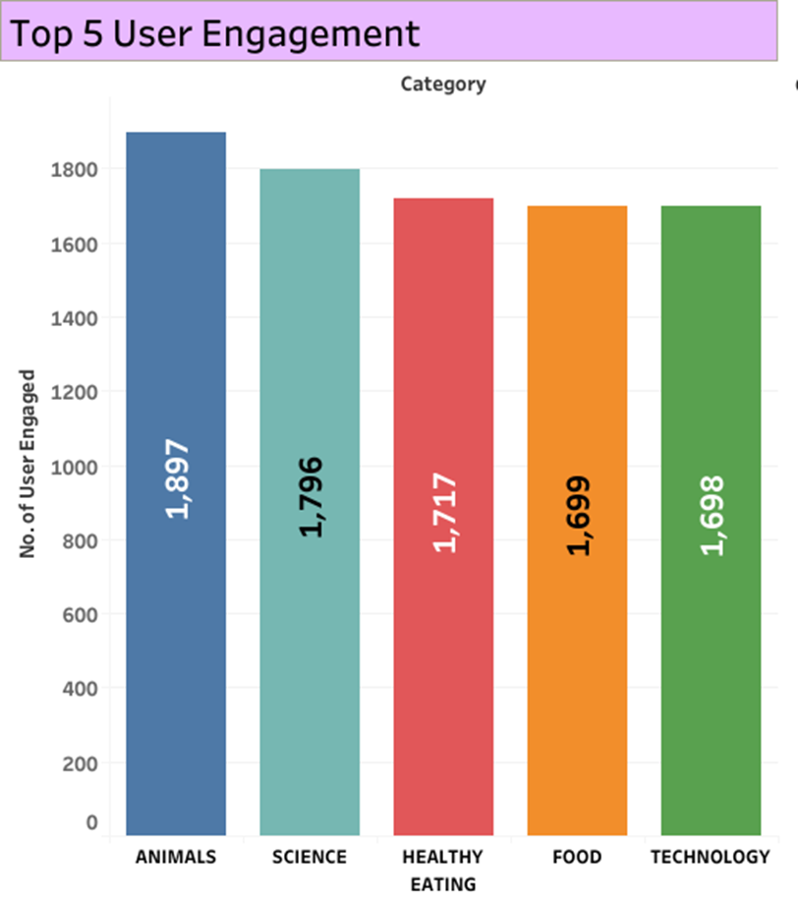
Top 5 Categories based Sentimental Score :
We gave the score based on their customer’s sentimental value and calculated for the top 5 categories. These are the top 5: Animal, Science, healthy eating, Food, and technology.
Top 5 Categories based on the user engagement :
We calculate the number of users engaged in the different categories. These are the top 5: Animal, Science, healthy eating, Food, and technology.

Slide 9
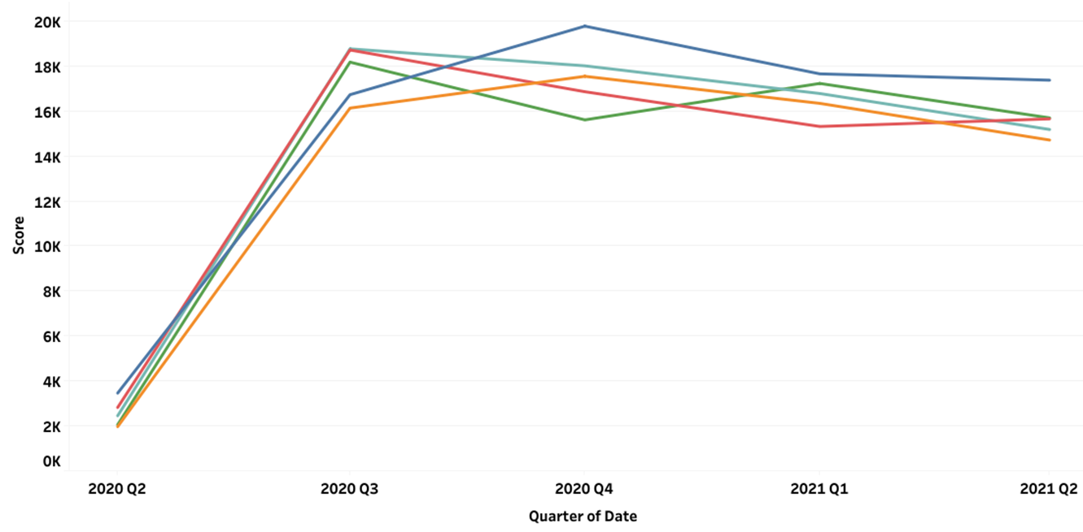
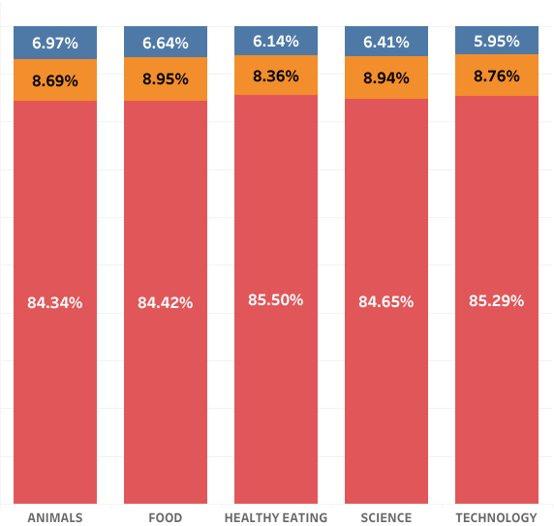
Journey of the Top 5 categories on the quarter basis:
It shows the sentimental score of the Top 5 categories in different periods which shows how much people engaged and reacted in the different quarters.
Percentage of the sentimental type in the top 5 categories :
These are the proportions of how much each sentimental type holds in the top 5 categories: Animal, Science, healthy eating, Food, and technology.
Red colour Positive
Yellow colour: Neutral
Blue colour: negative

Slide 10
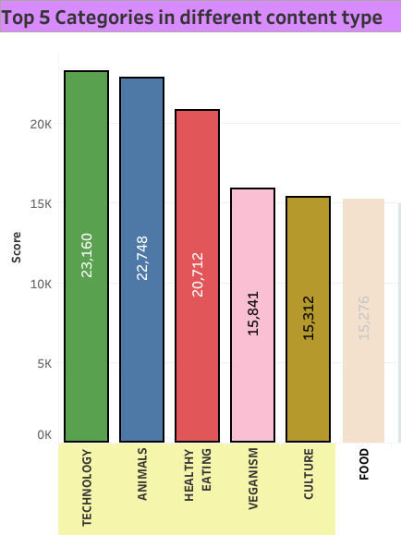
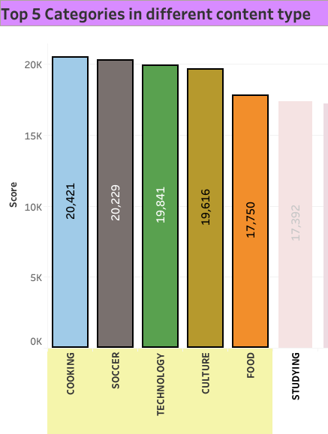
Top 5 categories: GIF
It shows the sentimental score of the Top 5 categories in the GIF content type which shows how much people engaged and reacted through the medium of GIF.
Top 5 categories: AUDIO
It shows the sentimental score of the Top 5 categories in the Audio content type which shows how much people engaged and reacted through the medium of Audio.

Slide 11
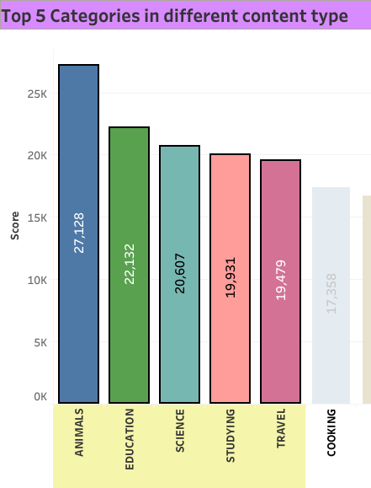
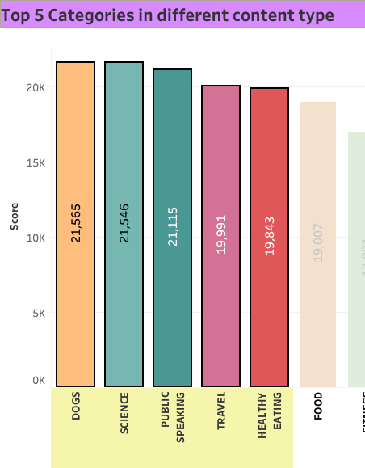
Top 5 categories: PHOTO
It shows the sentimental score of the Top 5 categories in the photo content type which shows how much people engaged and reacted through the medium of photos.
Top 5 categories: VIDEO
It shows the sentimental score of the Top 5 categories in the video content type which shows how much people engaged and reacted through the medium of video.

Slide 12

The report analyzes the performance metrics, sentimental value, and engagement of the top 5 content categories over the past month. Firstly, it identifies these categories based on customer engagement numbers. Secondly, it assesses them based on sentimental value and overall popularity. The report also tracks the journey of these categories across quarters, noting a significant growth trend after a slow start in the first quarter. It then delves into the distribution of different sentimental types within these categories. Lastly, it examines the top 5 categories across different content types, providing insights to inform decisions on content strategy. I hope it will help the Social Buzz to take decisions.
Summary

Slide 13

Thank you!
ANY QUESTIONS?

